Slide 1
Strava & weather: is there a correlation?
DS Group 7
Pieter, Luigi, Julius, Jasper & Ingmar

Slide 2
Overview
Intro to Strava
Project aim
Design plan
Implementation update
Further steps

Slide 3
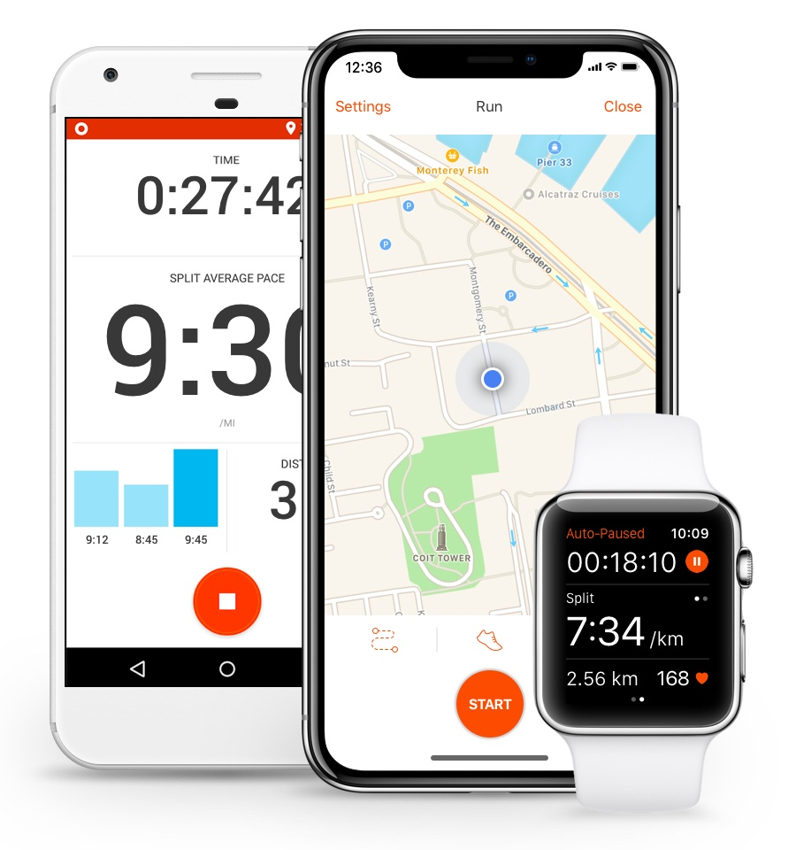
Intro to Strava
Activity tracker
Segments
Leaderboards
42 million users worldwide

Slide 4
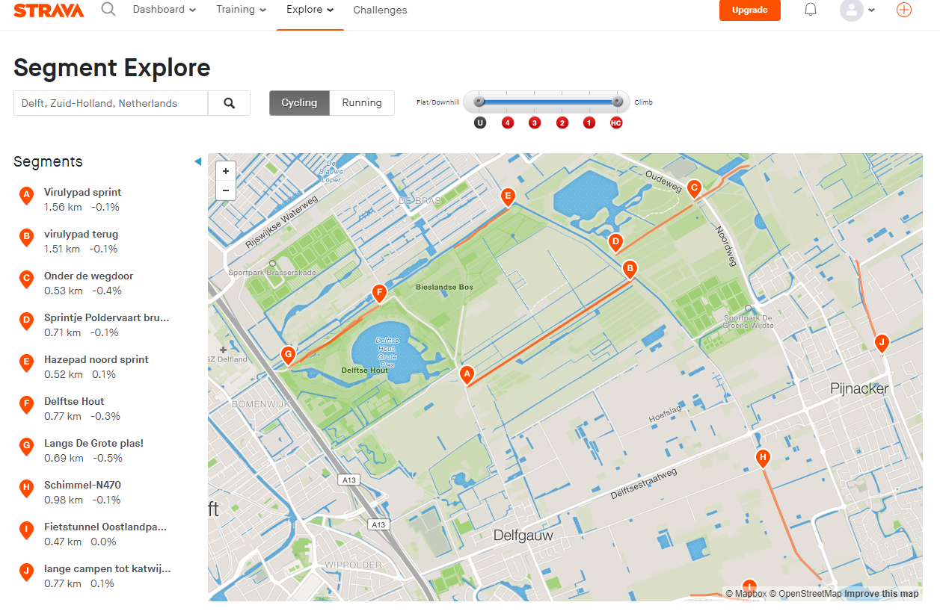

Slide 5
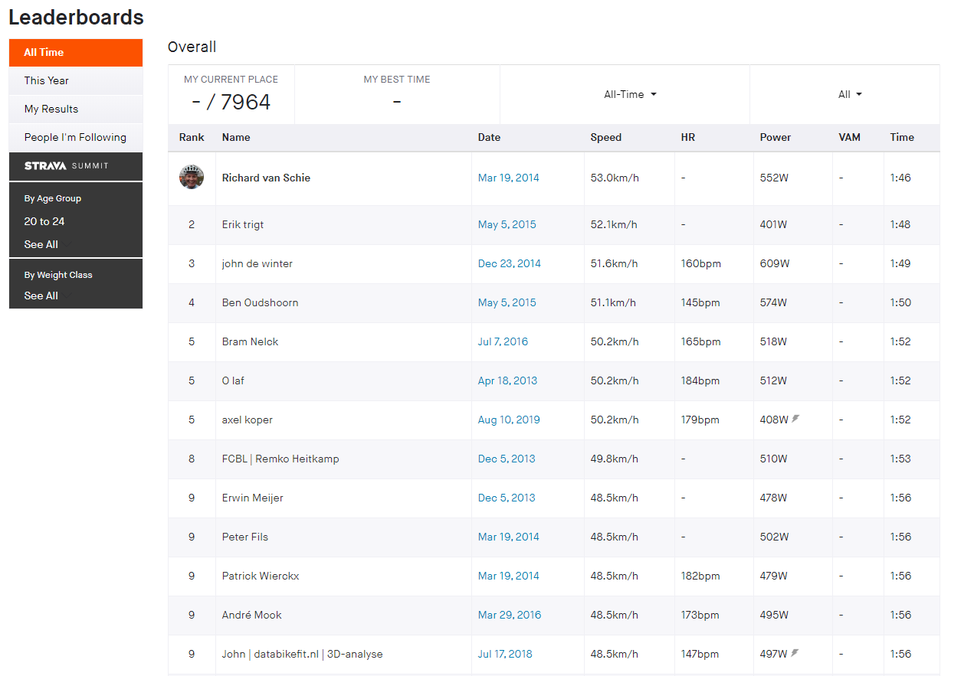

Slide 6
Project Aim
Find correlation between weather and places where Strava users cycle

Slide 7
Constraints
KNMI is limited to the Netherlands
Not all cyclists use Strava
Strava’s popularity over time
Defining a good weather scoring is difficult
Amount of requests

Slide 8
Design plan
Controller
Strava Module
Weather Module
Obtain data
Filter data
Weather score
Obtain data
Analysis
Heat maps
Base line

Slide 9
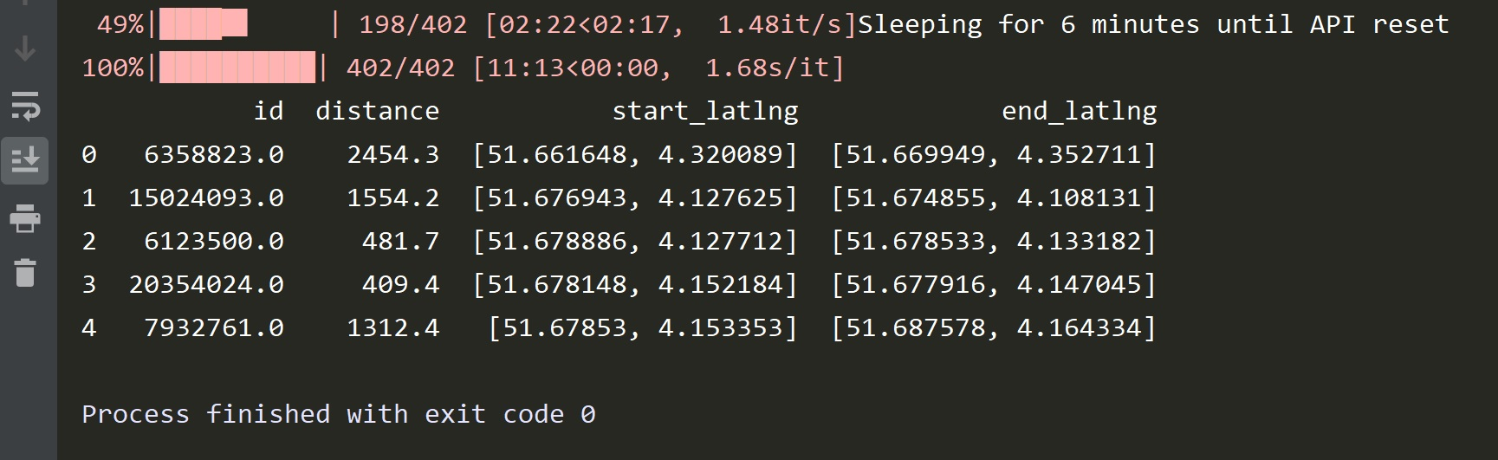
Strava Module

Slide 10
Demo: Visualization Module

Slide 11
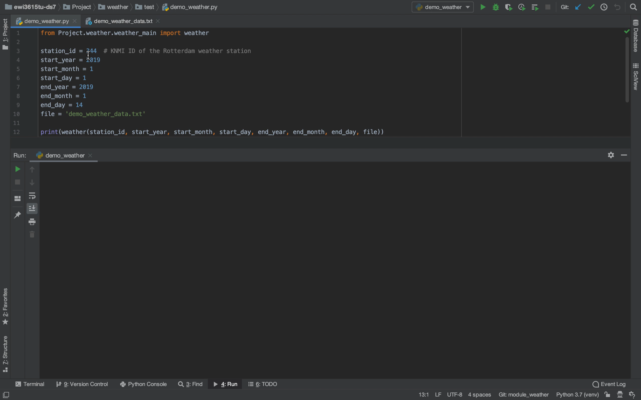
Demo: Weather Module

Slide 12
Implementation update
Weather module:
Works, weather scoring needs some refinement
Strava module:
Too many requests
Visualization module:
Finished

Slide 13
Further steps
Build analysis module
Scrape!

